Slide 1





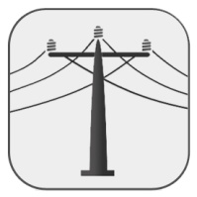


www.energypedia.info

Slide 2

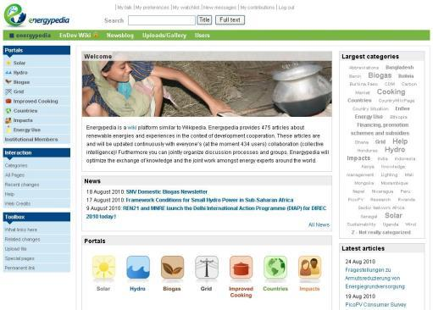
What is energypedia?
A platform which uses the wiki* philisophy and technology
User are responsible for the content
A knowledge platform with articles regarding renewable energies and development cooperation
A working platform for Sector Networks, projects, NGOs etc.
→ Vision: The leading knowledge and working platform for renewable energies in the context of development cooperation worldwide
*Wiki = System of web sites which cannot only be read by users but also be created and edited online

Slide 3



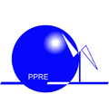




The leading independent knowledge and working platform for renewable energies in the context of development cooperation worldwide
Vision
Uni Oldenburg
GIZ-Wiki
Umweltmanagement
Partner
NL Agency
Daey Ouwens Fund
Kof 4413-Wiki
giz Energieeffizienz
Working Group
Fachverbund Energie in Sub-Sahara Africa

